Slide 1

DBI 101
June 2024
Day 1 - Intensive Intervention Institute
Sarah Benz, PhD| Sarah Arden, PhD

Slide 2



Introductions
Sarah Benz, PhD
Senior Researcher
Intensive TA Coordinator, NCII
Sarah Arden, PhD
Principal Researcher
Deputy Director, NCII

Slide 3

Logistics
Materials
  Participant handouts with notetaking space
  PowerPoint slides available through QR code
Share lessons learned and reflections on Twitter/X: @TheNCII

Slide 4

Barn Dance
Think: 30 seconds - How you are currently supporting students who are nonresponsive to Tier 2 interventions or current specially designed instruction.
Pair: with someone you don’t know, introduce yourself and discuss.
Share: whole group share out.

Slide 5
Agenda – Day 1
10:45 am - 11:20 am: Introduction to Intensive Intervention
11:20 am – 11:45 am: Overview of DBI
11: 45 am – 1:15 pm: Grub (Lunch Break)
1:15 pm – 2:00 pm: Continued, DBI Overview
2:00 pm – 2:15 pm Circle the Wagons (Break)
2:15 pm – 2:45 pm: Y’all Ready for This?
2:45 pm – 3:00 pm Circle Up

Slide 6
Learner Outcomes
By the end of the strand, participants will be able to:
Explain the rationale for intensive intervention
Describe the steps in the data-based individualization (DBI) process.
Identify lessons learned to improve implementation of DBI
Access and use National Center on Intensive Intervention (NCII) resources to support implementation of DBI
Assess your current capacity to support DBI and develop next steps

Slide 7
Introduction to Intensive Intervention

Slide 8



Why do we need intensive intervention?
Validated programs are not universally effective programs; 3% to 5% of students need more help (NCII, 2013)
Students with intensive needs often require 10–30 times as much practice as their peers to learn new information
(Gersten et al., 2009)
For students with intensive needs, co-occurring academic and behavioral needs are the rule not the exception
(Kuchle & Riley-Tillman, 2019)

Slide 9

Who needs intensive intervention?
    Students with disabilities who are not making adequate progress in their current instructional program and not meeting individualized education program (IEP) goals
    Students with persistently low academic achievement and/or high-frequency and/or high-intensity behavior
    Students in a tiered intervention program who are nonresponsive to interventions delivered with fidelity

Slide 10
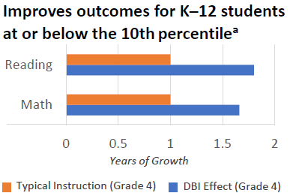
Benefits of Intensive Intervention
“In one year, 78% of students receiving intervention reached ambitious growth goals set using national norms. Thirty percent of students were exited from any kind of intervention.” —Bristol Warren Regional School District, Rhode Island
(Jung, McMaster, Kunkel, Shin, & Stecker, 2018; Scammacca, Fall, & Roberts, 2015)

Slide 11
Where does intensive intervention fit within a multitiered system of support (MTSS)?
Characteristics | Tier 1 | Tier 2 | Tier 3
Instruction/ Intervention Approach | Comprehensive research-based curriculum | Standardized, targeted small-group instruction | Individualized, based on student data
Group Size | Classwide (with some small-group instruction) | 3–7 students (as defined by developer) | No more than 3 students
Progress Monitoring | 1x per term | At least 1x per month | Weekly
Population Served | All students | Students at risk (typically 15% to 20% of student population) | Significant and persistent learning and/or behavioral needs

Slide 12
How do Tier 2 and Tier 3 compare?
Characteristics | Tier 2 | Tier 3 - DBI
Instruction/ Intervention Approach | Follow standardized evidence-based programs as designed | Use standardized evidence-based program as a platform, but adapt instruction based on student data
Duration and Time Frame | Use duration and time frame defined by developer | Increase frequency and/or duration to meet student needs
Group Size | 3–7 students (as defined by developer) | Decrease group size to meet student needs (no more than 3 students)
Progress Monitoring | At least monthly | Weekly
Population Served | Students at risk (typically 15% to 20% of student population) | Significant and persistent learning and/or behavior needs (typically 3% to 5% of student population)

Slide 13
How does intensive intervention relate to special education?
Students with disabilities must have access to intensive intervention.
Many students who require intensive intervention also are students with disabilities.
Intensive intervention can help educators design and deliver special education programming.
DBI should be part of the educational program for students with disabilities, not a separate process.
In schools implementing MTSS, students with disabilities may receive components of their intensive intervention across the levels of support.

Slide 14
Overview of DBI

Slide 15
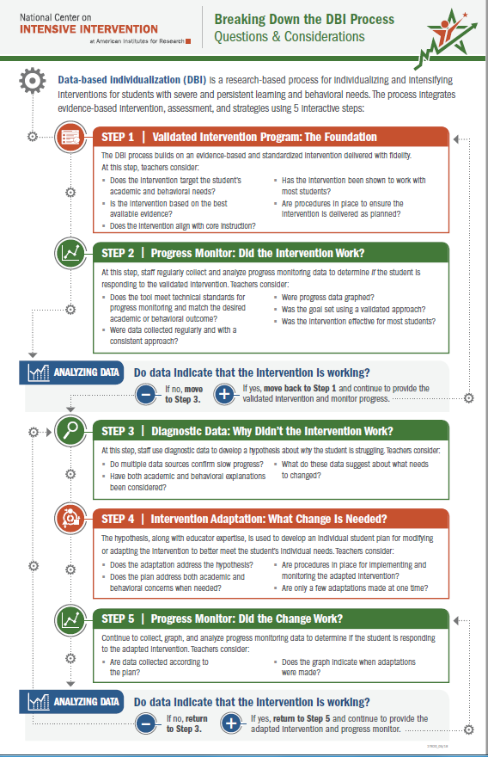
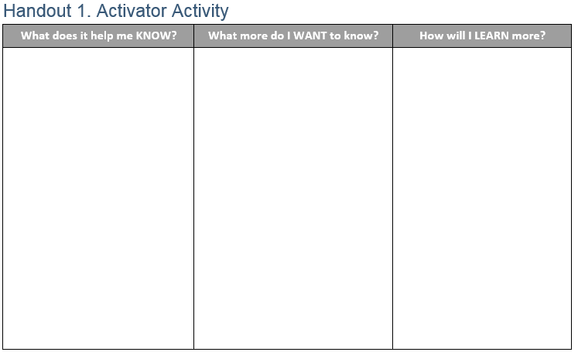
Activator Activity

Slide 16

What is data-based individualization (DBI)?
DBI Process
Data-based individualization (DBI) is a research-based process for individualizing and intensifying interventions for students with severe and persistent learning and behavioral needs.
The process integrates evidence-based intervention, assessment, and strategies.

Slide 17

Do I need a DBI team to implement DBI?
No. Individual teachers can independently implement DBI.
But three (or more) heads are always better than one when engaging in problem solving!

Slide 18
How does DBI support implementation of special education requirements?
DBI can help schools implement special education requirements within a comprehensive support system.
Referral and Eligibility Requirements
Ensure provision of intensive interventions to rule out lack of instruction.
Provide formal progress monitoring data that can be shared with parents.
Compare student performance to performance of peers.
IEP Development and Implementation
Provide data to develop present levels of academic achievement and functional performance statements.
Set ambitious, realistic IEP goals, and monitor progress toward those goals.
Develop specially designed instruction.
Provide estimates of level of service needed.

Slide 19
DBI Process
Validated intervention program, delivered
with fidelity
Progress monitoring
Diagnostic data used to develop a hypothesis
Adaptation to validated intervention
Continued progress monitoring, with adaptations occurring whenever needed to ensure adequate progress

Slide 20
DBI Step 1: Lay the foundation for DBI.
STEP 1: Start with a standardized, validated intervention program.

Slide 21

Why use validated evidence-based practices?
“I think it’s our professional duty as educators to use what is most likely to bring about improved student outcomes. And if you believe, as I do and most educators do, that multiple high-quality experimental research studies are the best way, the most reliable way, to determine whether something works, then evidence-based practices just give you the best bet that a practice will work.”

Slide 22

Can I still implement DBI if I don’t have a standardized, evidence-based program (EBP)?
I can tell you’re struggling with fractions, Tony, but there aren’t any EBPs for kids in your grade. Maybe check back in a few years?

Slide 23
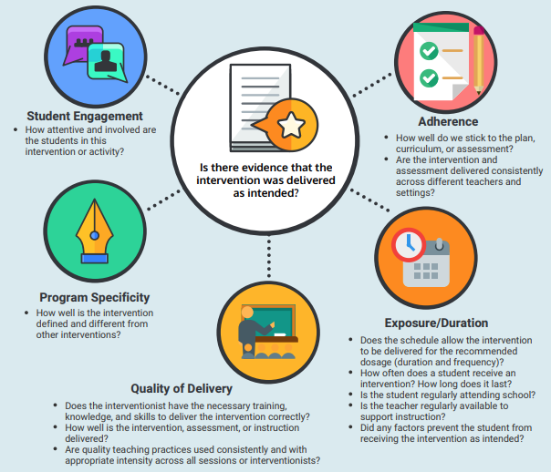
Five Elements of Fidelity
(Dane & Schneider, 1998; Gresham et al., 1993; O’Donnell, 2008)

Slide 24
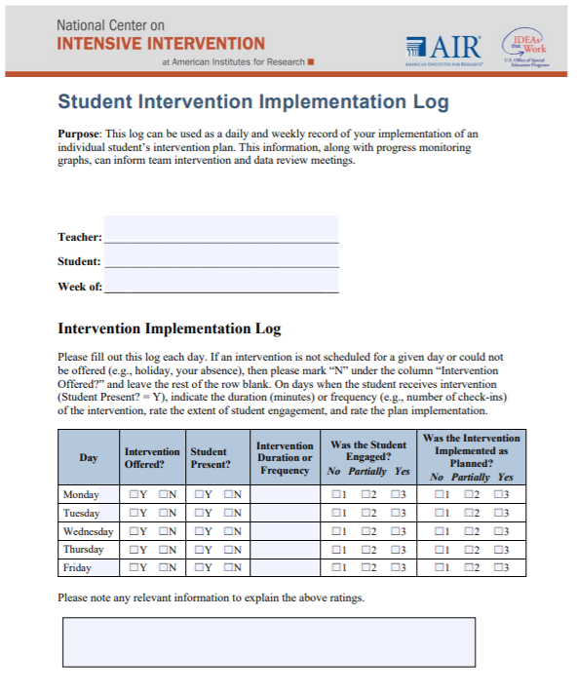
Tools to Support Monitoring Implementation Fidelity

Slide 25
Chat Time: Validated Intervention Programs
Reflect: To what extent do students in your school have access to validated interventions in reading, mathematics, and/or behavior delivered with fidelity?
Review the tools introduced in the previous three slides. How can these tools help support your implementation of validated intervention programs?
Consider: What additional information or support might we need?

Slide 26
DBI Step 2: Did the intervention work?
STEP 2: Develop a progress monitoring plan that includes an ambitious goal.

Slide 27
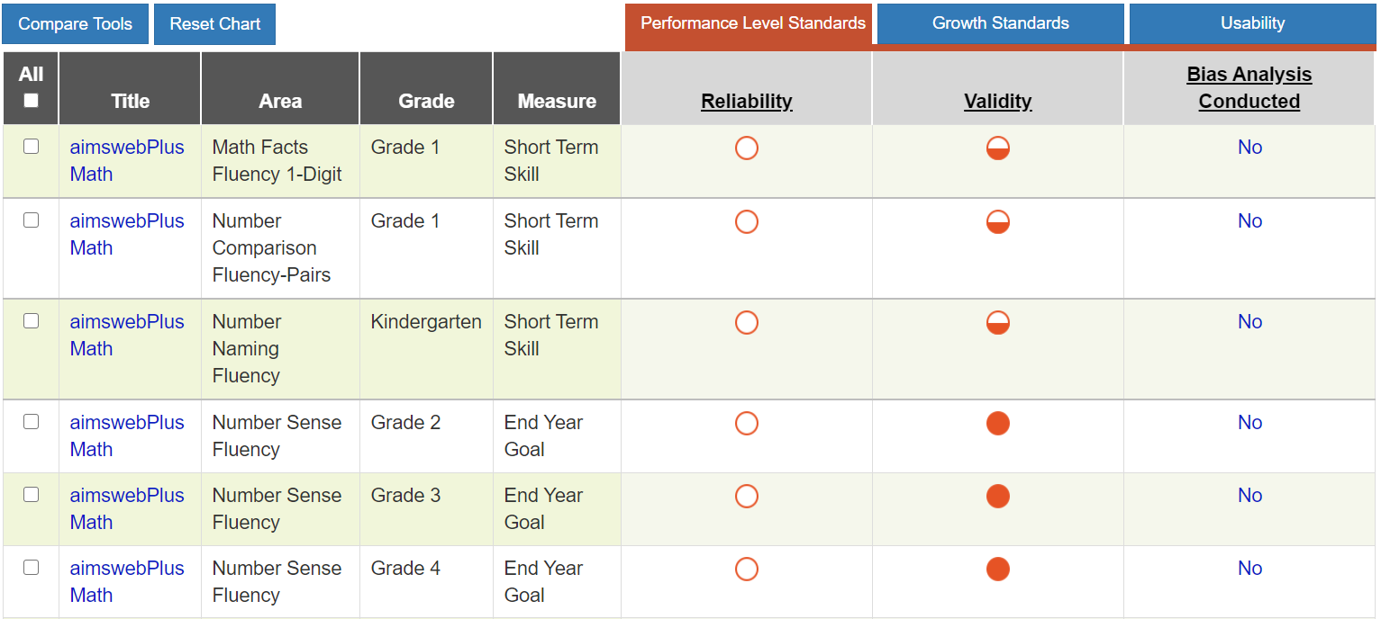


Tools to Support Collecting Valid Reliable Data for Progress Monitoring
Academic Progress Monitoring Tools Chart
Behavior Progress Monitoring Tools Chart
Strategies for Setting High-Quality Academic Individualized Education Program Goals
Strategies for Setting Data-Driven Behavioral Individualized Education Program Guide

Slide 28
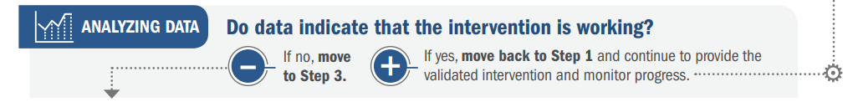
Analyzing Data: Academics
Intervention

Slide 29
Analyzing Data: Academics (part 2)
Intervention

Slide 30
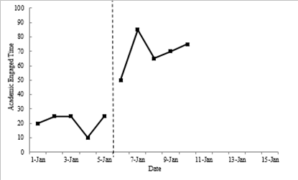
Analyzing Data: Behavior
Goal line

Slide 31
Chat Time: Progress Monitoring
Reflect:
  How do we know whether a student is responding to an intervention?
  How do we currently collect and use progress monitoring data?
Consider:
  What additional information or support might we need?

Slide 32
DBI Step 3: Why didn’t the intervention work?
STEP 3: Use informal diagnostic data to develop a hypothesis about WHY the student is not responding.

Slide 33
Integration of Academics and Behavior
Skill deficit
Avoidance behavior
Removal from task

Slide 34
Key Questions To Guide Hypothesis Development and Intensification
Does evidence suggest that the intervention is expected to lead to improved outcomes (strength)?
Will the group size, duration, and frequency provide sufficient opportunities to respond (dosage)?
Does the intervention match to the student’s identified needs (alignment)?
Does it assist the student in generalizing the learned skills to general education or other tasks (attention to transfer)?
Does the intervention include elements of explicit instruction (comprehensiveness)?
Does the student have opportunities to develop the behavior skills needed to be successful (behavioral support)?
Can the intervention be easily integrated into academic instruction (academic support)?
Can the intervention be individualized with a data-based process to meet student needs (individualization)?

Slide 35
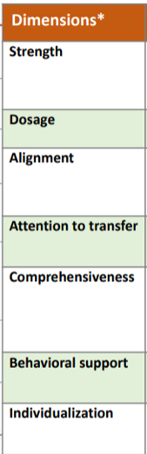
Using Diagnostic Data to Develop a Hypothesis
Teacher reviews classroom assessment data and conducts observations of the student’s learning behavior. Behavior observations suggest that the student struggles to master skills as quickly as the student’s same-age peers and needs more practice than the peers.
Hypothesis: If the student is provided additional opportunities of direct instruction, feedback, and practice on target skills, then the student would move to mastery of these skills more quickly.

Slide 36
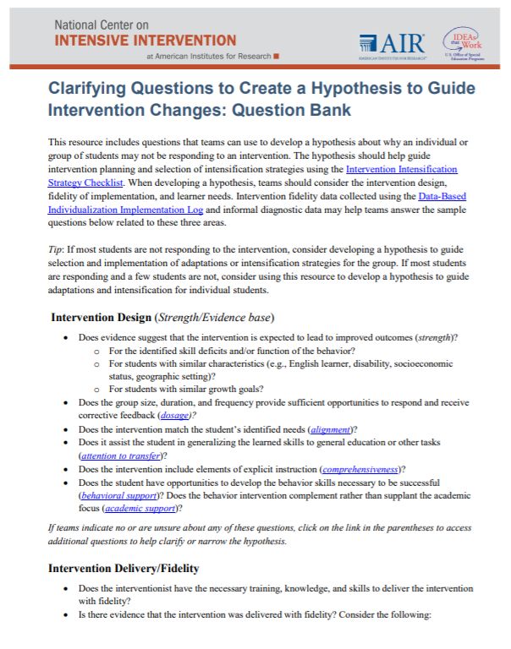
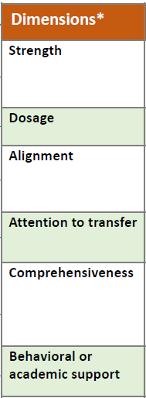
Tools for Analyzing Informal Diagnostic Data

Slide 37
DBI Step 4: What change is needed?
STEP 4: Intensify and individualize the intervention to address the hypothesis.

Slide 38
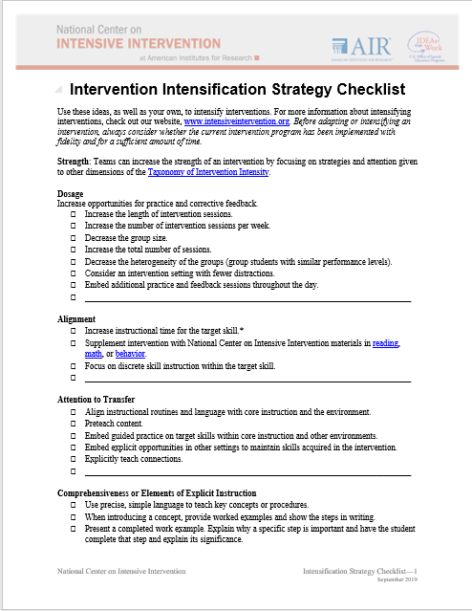
Adapting the Intervention
Tips for Successful Intensification
Select strategies that address the hypothesis.
Select a few important strategies.
Consider easier change(s) first:
      Increase dosage (i.e., intervention frequency, length of sessions, or duration).
      Decrease group size.
      Decrease heterogeneity of the
      intervention group.

Slide 39
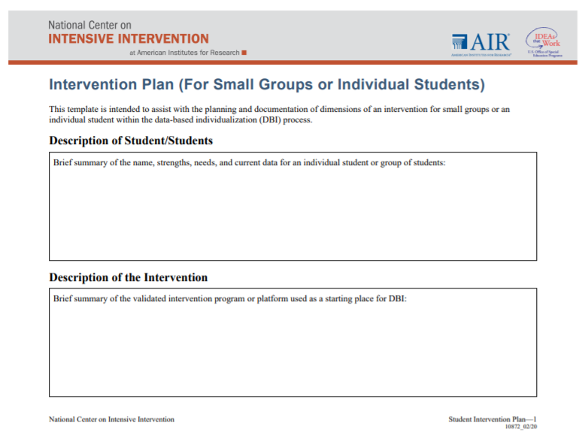
Implementation Monitoring: Was the adapted intervention delivered with fidelity?
Fidelity is still important!
  Focus on fidelity to the adapted student plan.

Slide 40
Chat Time: Hypothesis Development and Adapting The Intervention
Reflect
How do you currently analyze diagnostic data to make decisions about students' needs?
How are you currently adapting interventions to meet students' needs?

Slide 41
DBI Step 5: Did the change work?
STEP 5: Monitor the student’s response to the adaptation (at least 4–6 data points).

Slide 42
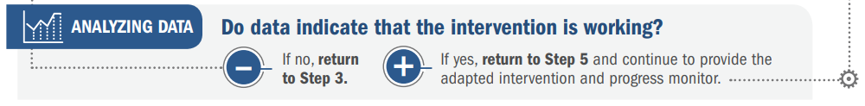
Academics: Is the student responding to the adapted intervention?
Intervention
Adaption 1 Phase Line

Slide 43
Behavior: Is the student responding to the adapted intervention?

Slide 44
DBI is an ongoing process based on student responsiveness to the intervention.

Slide 45
Activator Activity: Revisited

Slide 46
Y’all Ready for This?

Slide 47
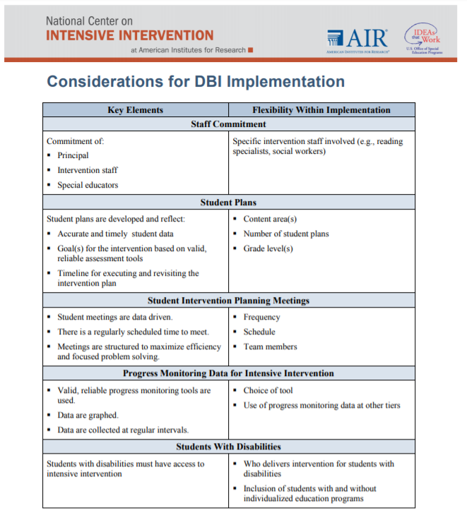
Key Elements for DBI Implementation
Staff commitment
Student plans
Student intervention planning meetings
Progress monitoring data for intensive intervention
Students with disabilities

Slide 48
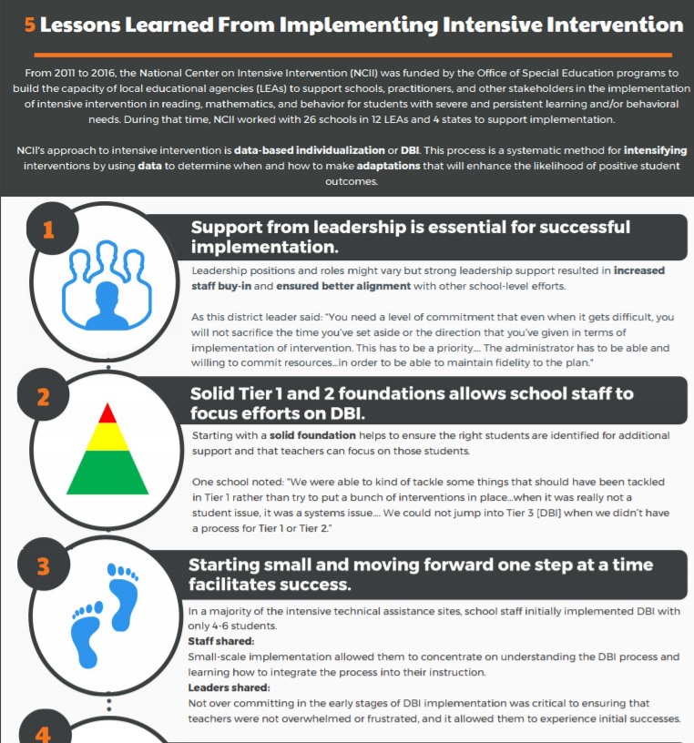
5 Lessons Learned From Implementing Intensive Intervention

Slide 49
1. Support from leadership is essential.
“You need a level of commitment that even when it gets difficult, you will not sacrifice the time you’ve set aside or the direction that you’ve given in terms of implementation of intervention. This has to be a priority. . . . The administrator has to be able and willing to commit resources . . . in order to be able to maintain fidelity to the plan.”
District Administrator

Slide 50
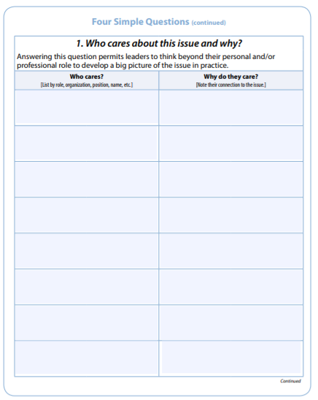

Leadership . . .
Establishes purpose and focus to build a shared vision:
  What is the work that you are trying to implement, and why is this work important to you and others you work with?
  Why should we care about DBI and intensive intervention?
Shapes culture and expectations
Communicates with and promotes buy-in and involvement of staff in decision making
Provides supporting resources and structures, including assessments, interventions, professional development, and staff time
Leading by Convening

Slide 51
Considerations for DBI Implementation
Strong leadership provides the enabling context to ensure the key elements are considered
Culture and vision
Time to implement
Resources
Time to implement
Resources
Policies and practices

Slide 52

2. Ensure solid Tiers 1 and 2.
Starting with a solid foundation helps to ensure the right students are identified for additional support and that teachers can focus on those students.
Ensure appropriate infrastructures are in place:
    Screening
    Progress monitoring
    Data-based decision making
    High-quality instruction and intervention

Slide 53
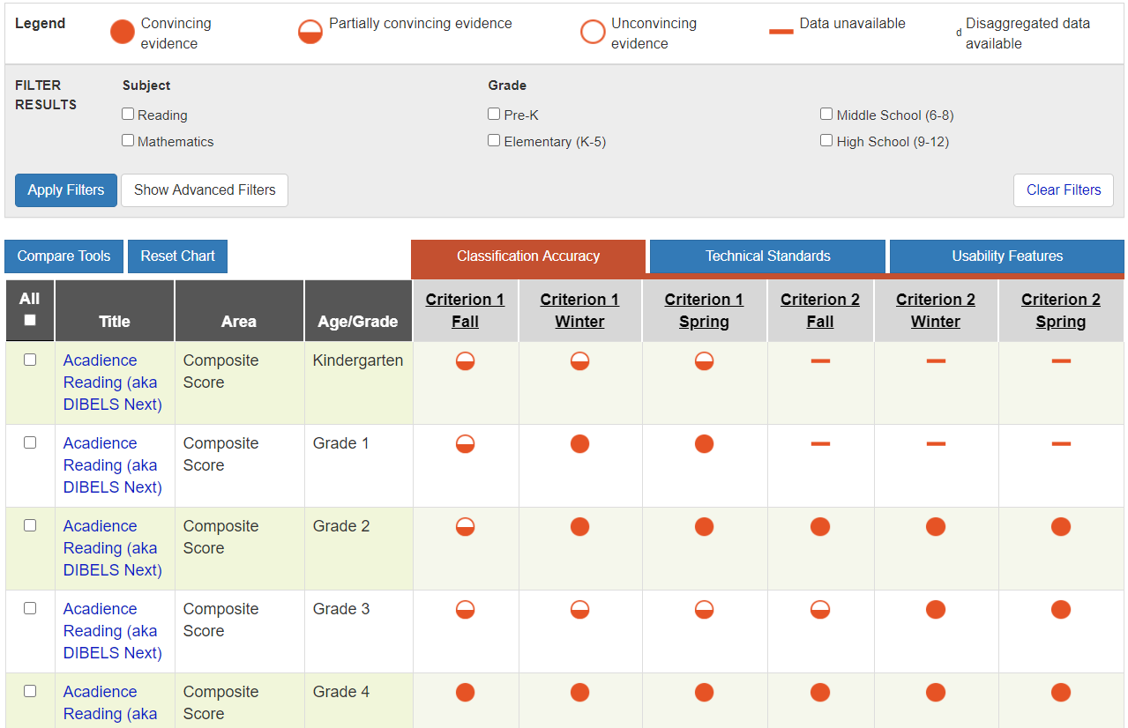
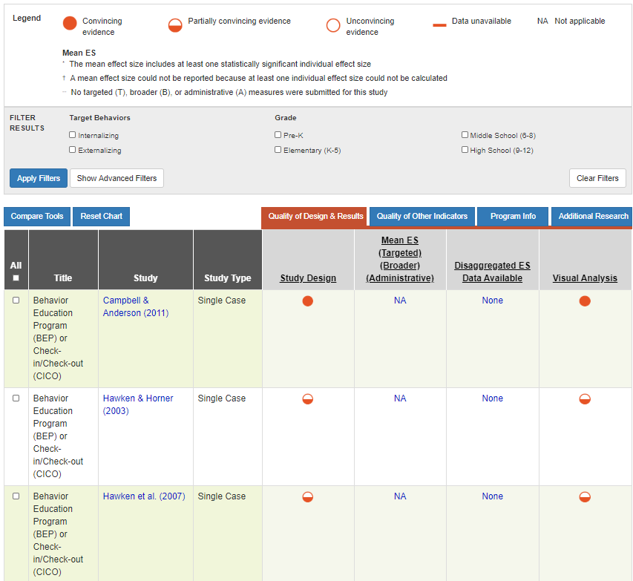
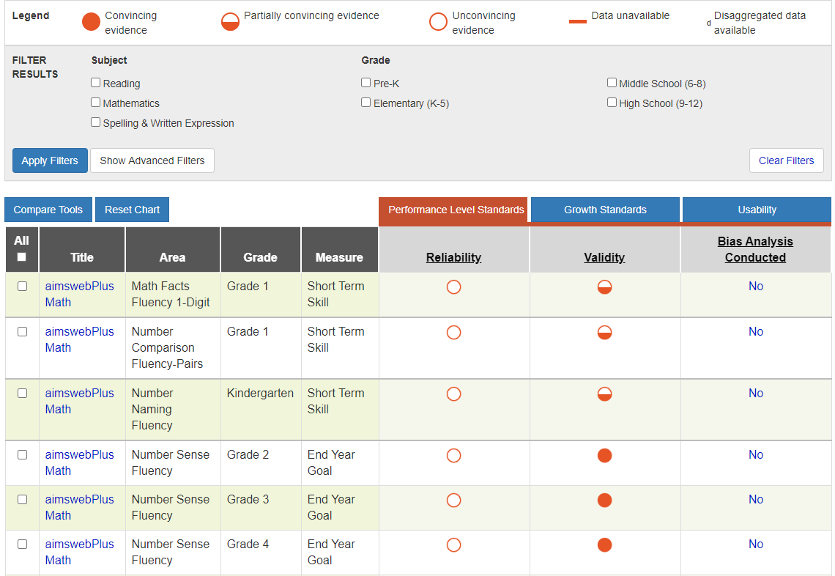
Tiers 1 and 2 Resources: Academic and Behavior Assessment and Intervention Tools Charts
Screening Tools Chart
Intervention Tools Chart
Progress Monitoring Tools Chart

Slide 54
3. Start small and focus on one step at a time.
Staff shared: Small-scale implementation allowed them to concentrate on understanding the DBI process and learning how to integrate the process into their instruction.
Leaders shared: Not overcommitting in the early stages of DBI implementation was critical to ensuring that teachers were not overwhelmed or frustrated and to allowing them to experience initial successes.

Slide 55
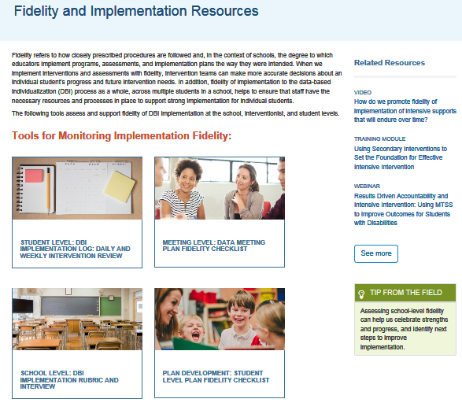
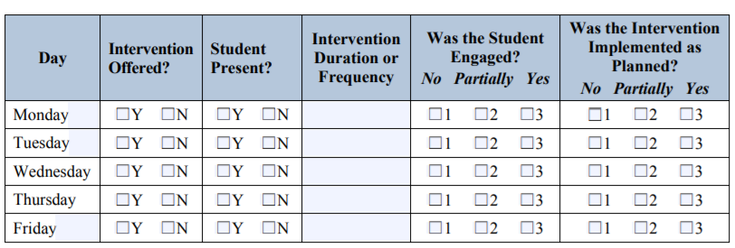
Resources: Monitoring Fidelity
Start by focusing on doing things consistently as designed before scaling up.
https://intensiveintervention.org/implementation-intervention/fidelity

Slide 56
4. Use formalized procedures and standard protocols.
Ensure processes are clearly documented (e.g., scripted meeting agendas and clear guidelines).
Provide ongoing professional development to ensure that the knowledge is not placed with a few key individuals and to maintain sustainability when staffing changes.

Slide 57
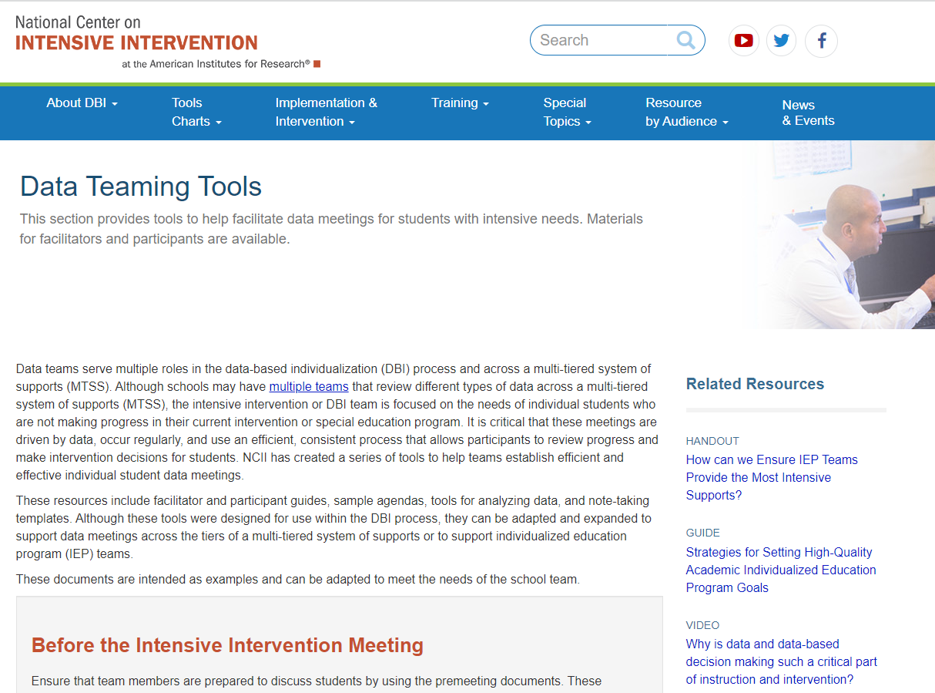
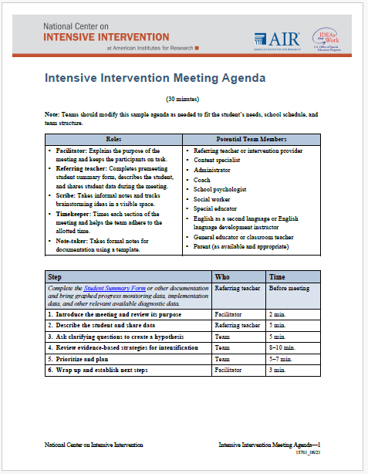
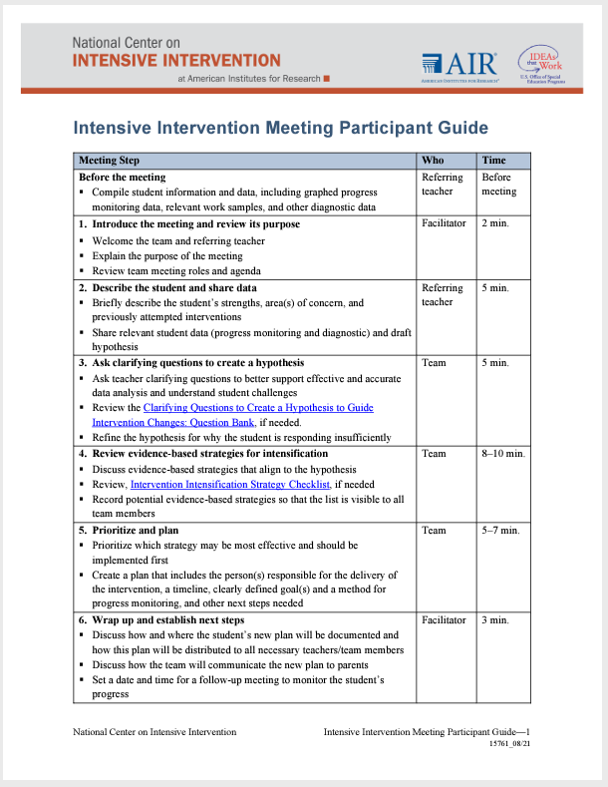
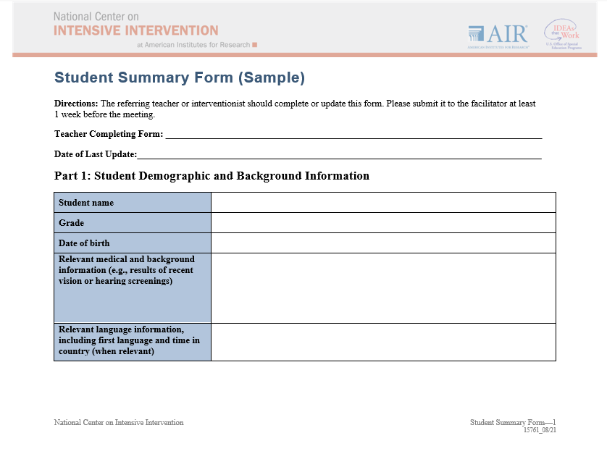
Facilitated Meetings to Review Data
https://intensiveintervention.org/implementation-intervention/data-teaming

Slide 58
Developing Student Plans
  Clearly articulate:
  Scheduling
  Fidelity data collection
  Responsibilities
  Communication
  Follow-up
58

Slide 59

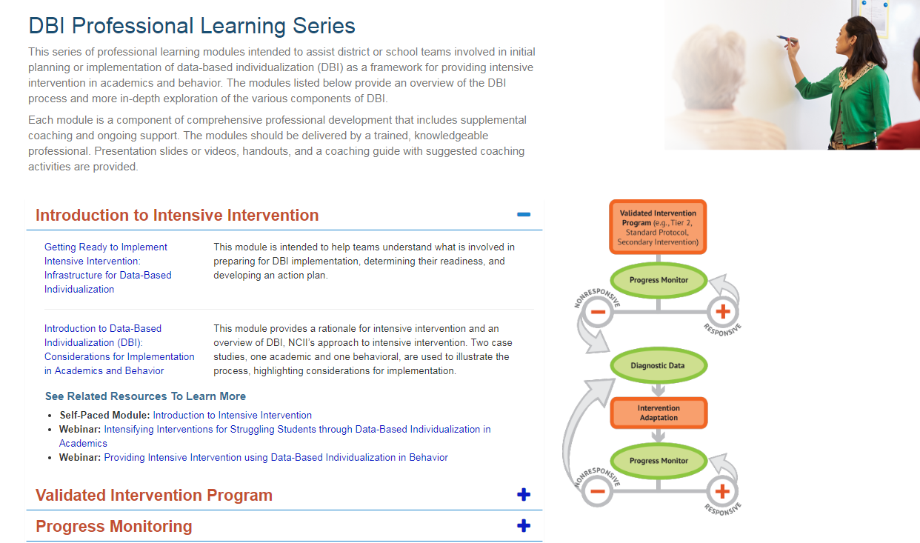
Professional Learning Resources
https://intensiveintervention.org/training/dbi-training-materials
https://intensiveintervention.org/training/online-learning-modules

Slide 60
Formalized Procedures
These procedures ensure that:
Student plans are consistently developed.
Student meetings occur at regular intervals.
Data are collected and graphed consistently.

Slide 61
5. Commit to the process.
It is important to commit to implementing the DBI process for an
extended period and to know that the process will likely be bumpy along the way.
“Data-based decision making is not for wimps . . . You really got to go in knowing that it’s hard work. . . . Once you’ve made that commitment, you can’t just give up. . . . The only answer we’ve found so far is sometimes just going ahead and doing what we need to do and having the people look at the success.” (TA Recipient NCII 2012-2016)

Slide 62
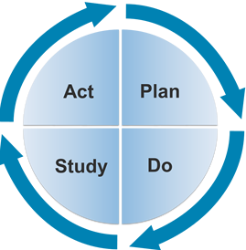
Create a culture of continuous improvement.
“The last piece of advice I would give to an administrator would be to never be satisfied with your school or district’s current level of performance. There is always room for improvement! An effective administrator continuously works with staff to reflect on the successful implementation of MTSS and how to make the system even more efficient and effective for students.”
~Paul Elery, Principal, Harvard Elementary School, Franklin Pierce School District

Slide 63
Activator Activity Update

Slide 64
Kelsey’s Case Study

Slide 65

DBI for Kelsey
Background: Kelsey presented serious reading problems at the beginning of second grade. Classroom assessments and diagnostic assessments identified three deficit areas: phonological awareness, word study, and reading fluency.
Intervention program: Kelsey’s teacher selected a research-validated program that addressed phonological awareness, word study, and fluency skills.

Slide 66

DBI requires ongoing progress monitoring to determine responsiveness.

Slide 67
Progress Monitoring Plan
  Tool: Passage Reading Fluency (PRF)—second grade
  Frequency: Weekly
  Review Date: Four to six weeks
  Baseline: 23 WRC
  Target Goal (end of year): 90 WRC

Slide 68
Progress Monitoring Graph
Spring Benchmark:
90 WRC

Slide 69

Individual teacher or teams of teachers assess student’s responsiveness.

Slide 70
Progress Monitoring: Does Kelsey need DBI?

Slide 71
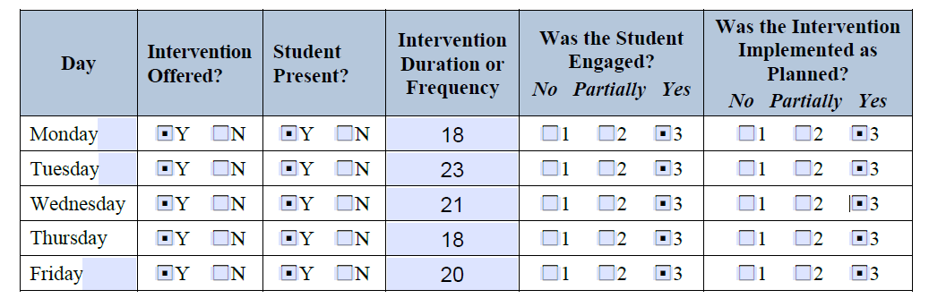
Delivered with fidelity?

Slide 72
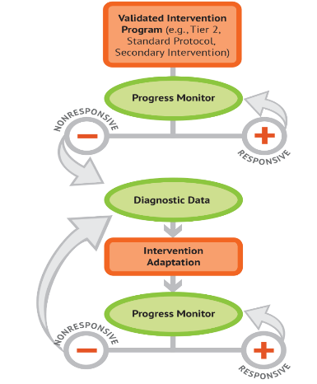
Diagnostic Data:
What changes are needed to support Kelsey?

Slide 73
Using Diagnostic Data to Develop Hypothesis to Intensify
Teacher reviews Kelsey’s classroom assessment data and conducts observations of her learning behavior. Behavior observations suggest that Kelsey struggles to master skills as quickly as her same-age peers and needs more practice than her peers.
Hypothesis: If Kelsey is provided additional opportunities to receive direct instruction, feedback, and practice on target skills, she will progress toward mastery of these skills more quickly.

Slide 74

Intervention Adaptation:
Use diagnostic data to adapt the intervention.

Slide 75
Using Diagnostic Data to Develop Hypothesis to Intensify (part 2)
Kelsey’s teacher reviews her classroom assessment data and conducts observations of her learning behavior. Observations suggest that Kelsey struggles to master skills and needs more practice than her same-age peers.
Hypothesis: If Kelsey is provided additional opportunities of direct instruction, feedback, and practice on target skills, she would move to mastery of these skills more quickly.

Slide 76
Rating Table
Intervention Dimensions | Evidence | Adaptation 1
Strength | ES = Between 0.35 to 0.49
Dosage | Group size: six students Session length: 20 minutes per session Frequency: five sessions per week | Provide 40 minutes each session in smaller group (3)
Alignment | Explicit instruction covering skills deficit areas, PA, word study and fluency
Attention to transfer | Builds on previously learned skills; not clearly connected to Tier 1 content
Comprehensiveness | Includes three explicit instruction principles
Behavioral support | None found but doesn’t appear needed for student

Slide 77
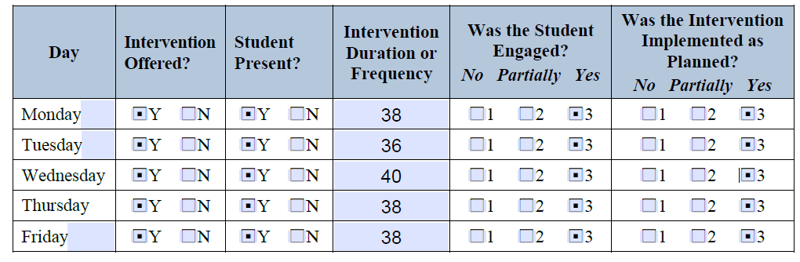
Was the intervention adaptation delivered with fidelity?
Duration ~ 40 minutes per session

Slide 78

Progress monitor and assess the impact of the adaptation.

Slide 79
Progress Monitoring:
Is Kelsey responding to the intervention?
Intervention
Adaption 1 Phase Line

Slide 80

Again, DBI is an ongoing process based on student responsiveness to the intervention.

Slide 81
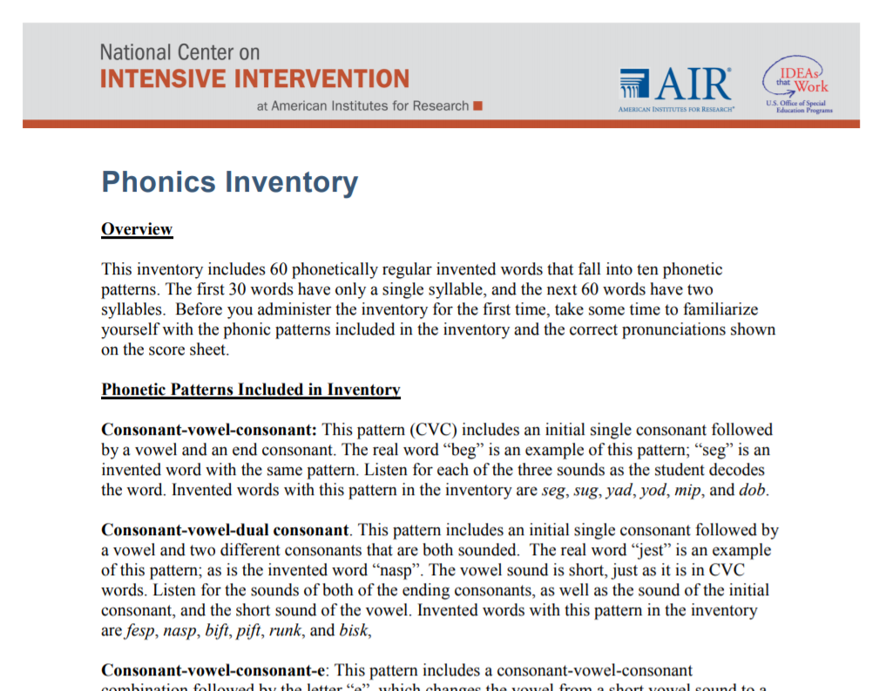
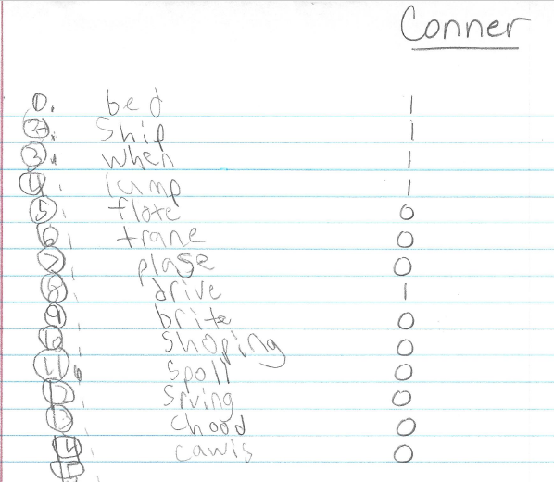
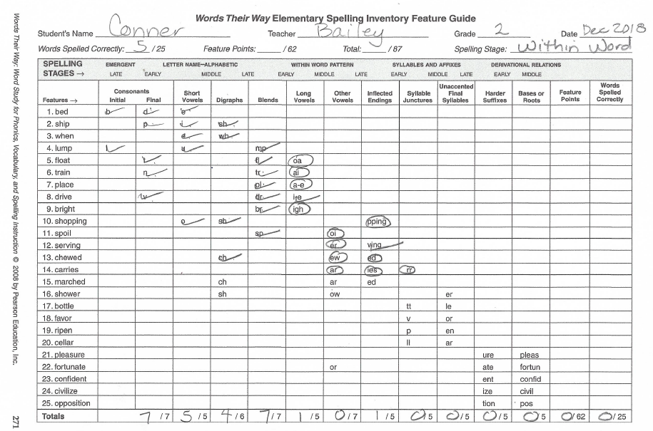
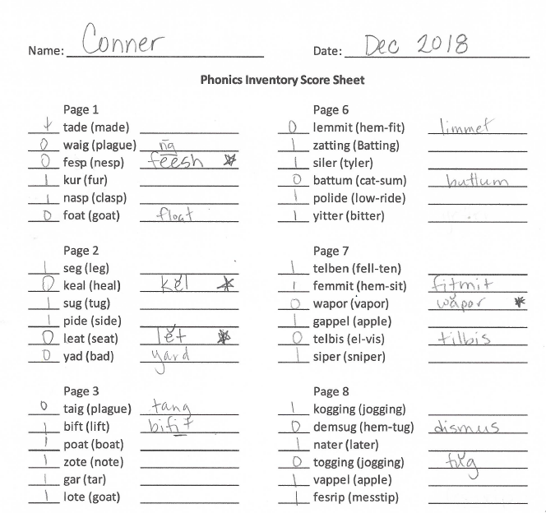
Informal Diagnostic Data Sources in Literacy
Consider a wide range of data sources to gather information about what literacy skill a student is struggling with.
Kelsey
Kelsey
Kelsey

Slide 82
What do you recommend?
Diagnostic data indicated Kelsey had difficulty applying decoding strategies to words with short and long vowels, especially “i” and “e.”
Observations also suggest that she needs the following instructional principles to benefit from decoding instruction:
Concrete, repeated opportunities to correctly practice the skill and receive feedback
Precise, simple language to introduce the lesson
Frequent checks for retention with reteaching as needed

Slide 83
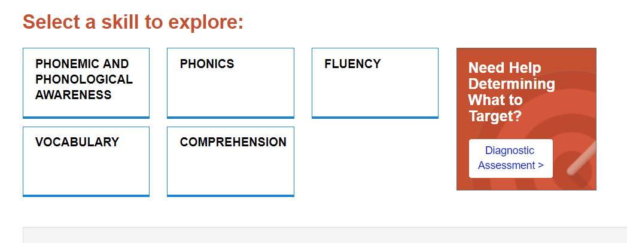
Lesson Plan Selection

Slide 84
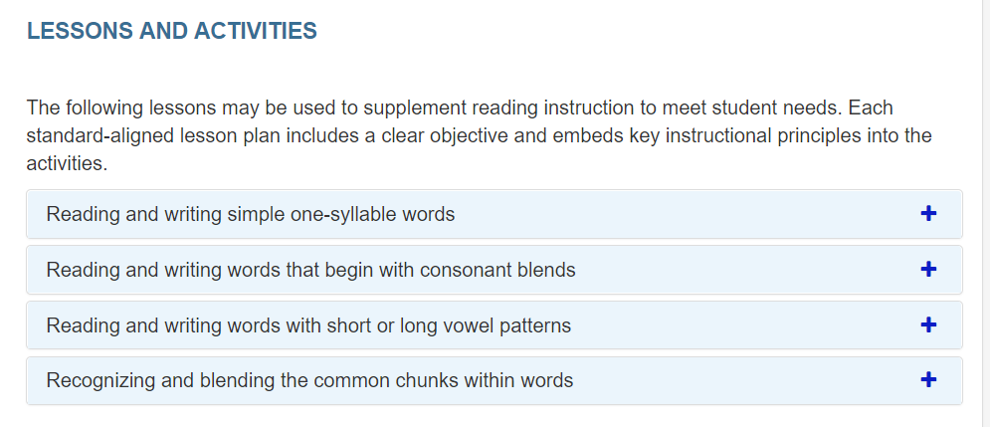
Lesson Plan Selection: Zoomed In

Slide 85
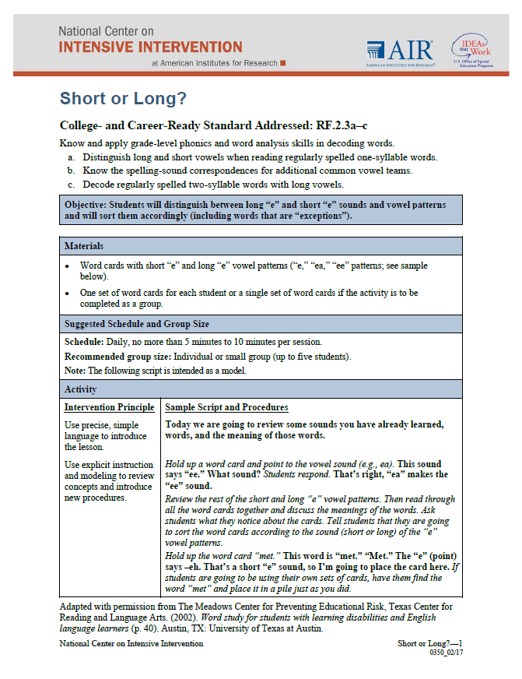
NCII Resources

Slide 86
Rating Table 2
Intervention Dimensions | Evidence | Adaptation 1 | Adaptation 2
Strength | ES = Between 0.35 and 0.49
Dosage | Group size: six students Session length: 20 minutes per session Frequency: five sessions per week | Provide 40 minutes each session in smaller group
Alignment | Explicit instruction covering skills deficit areas, PA, word study, and fluency
Attention to transfer | Builds on previously learned skills; not clearly connected to Tier 1 content
Comprehensiveness | Includes three explicit instruction principles |  | Provide additional explicit instructional strategies
Behavioral support | None found but doesn’t appear needed for student

Slide 87
Progress Monitoring: Is Kelsey responding to the adapted intervention?
Intervention
Adaptation 1
Adaptation 2 Phase Line

Slide 88

DBI is an ongoing process.

Slide 89
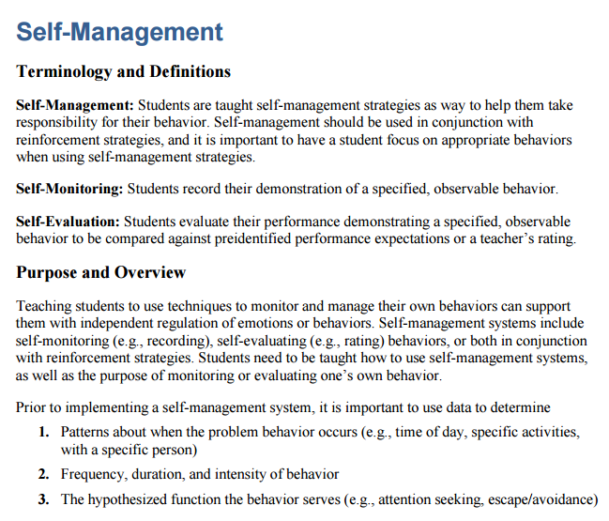
Using Data to Intensify the Intervention
Behavior Strategies to Support Intensifying Interventions
Fidelity and observation data indicate that Kelsey has become easily frustrated and less engaged in the intervention than her peers. Data indicate that she can learn the skill if she attends to the task.
Hypothesis: If Kelsey was more engaged and able to manage her frustration, she would benefit more from the intervention.

Slide 90
Rating Table 3
Intervention Dimensions | Evidence | Adapt 1 | Adapt 2 | Adapt 3
Strength | ES = Between 0.35 and 0.49
Dosage | Group size: six students Session length: 20 minutes per session Frequency: three to four sessions per week | Provide 40 minutes each session in smaller group
Alignment | Explicit instruction covering skills deficit areas, PA, word study, and fluency
Attention to transfer | Builds on previously learned skills; not clearly connected to Tier 1 content
Comprehensiveness | Includes three explicit instruction principles |  | additional explicit instructional strategies
Behavioral support | None found but doesn’t appear needed for student |  |  | Implement engagement and self-regulation strategy

Slide 91
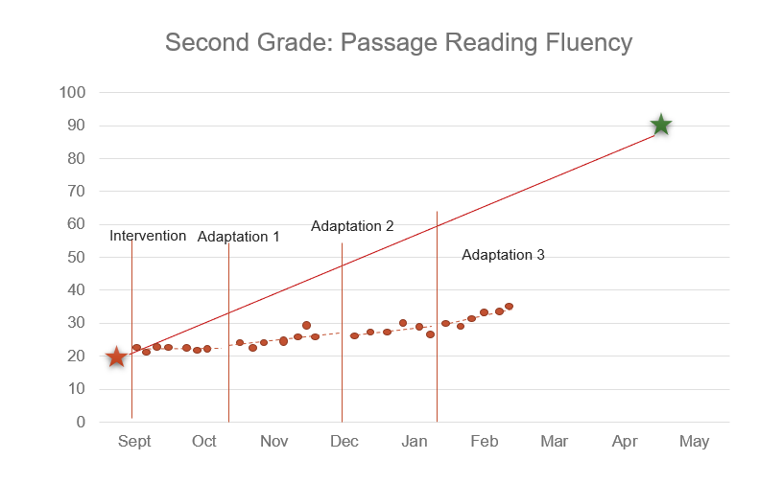
Is Kelsey responding to the adapted intervention? What would you do?

Slide 92

Circle Up

Slide 93
Preview Day 2 Agenda
9 am – 9:15 am: Howdy! Jawing Activity
9:15 am – 10 am: Hanging Onto One’s Fiddle (Assessing your capacity)
10 am – 10:30 am: Ponderin’ Time (Action Planning)
10:30 am – 10:45 am: Share out
10:45 am – 11 am: Hanging up our Hats, I Reckon'

Slide 94
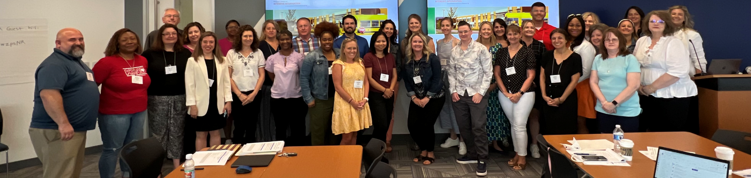
DBI 101
June 2025
Day 2
Sarah Benz, PhD & Sarah Arden, PhD

Slide 95
Preview Day 2 Agenda
9 am – 9:15 am: Howdy! Jawing Activity
9:15 am – 10 am: Hanging onto One’s Fiddle (Assessing your capacity)
10 am – 10:30 am: Ponderin’ (Action Planning)
10:30 am – 10:45 am: Share out
10:45 am – 11 am: Hanging up our Hats, I Reckon' (Wrap up and Next Steps)

Slide 96

Howdy! Jawing Activity - Reflect
Think:
Looking back, what lessons do you think are most critical for your school/district/state to focus on for DBI implement to be successful?
What are potential challenges or barriers to DBI implementation? What are some potential solutions?
Share one barrier and one solution with a partner!

Slide 97
Hanging Onto One’s Fiddle (Assessing Your Capacity)

Slide 98
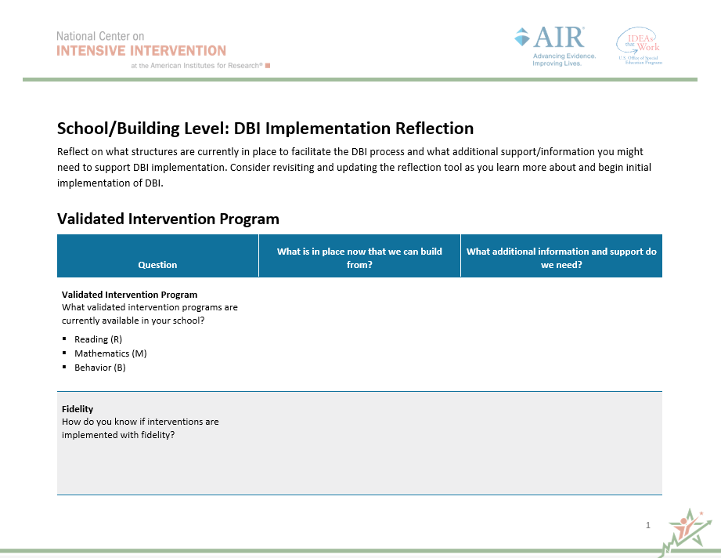
DBI Implementation Reflection
School/Building Level

Slide 99
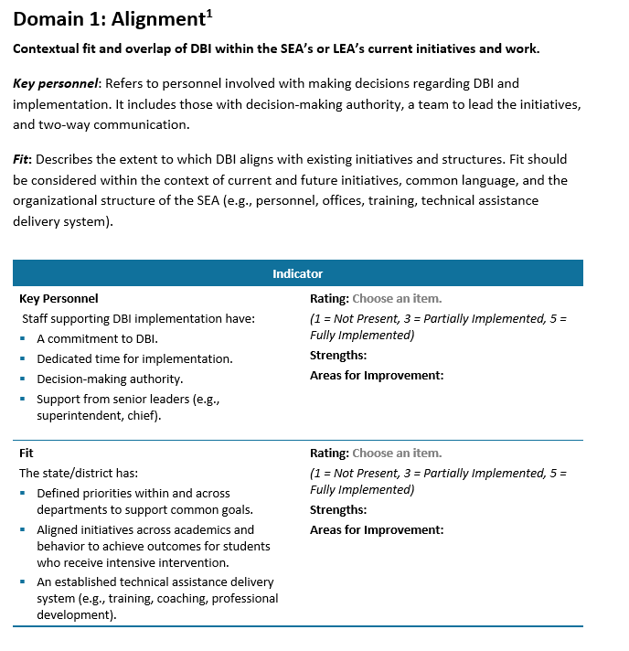
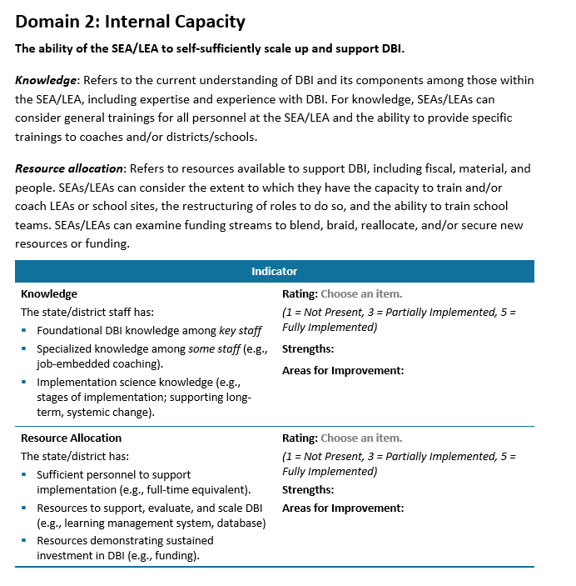
DBI Implementation Reflection
District/State

Slide 100
Ponderin’ Time
(Action Planning)

Slide 101
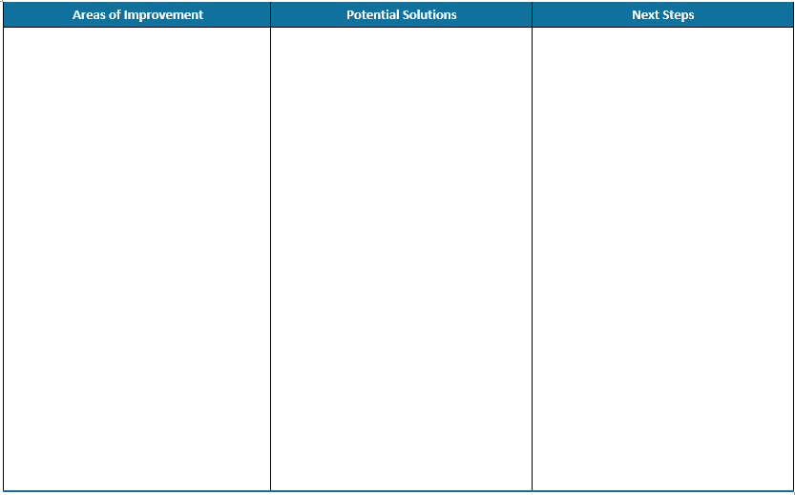
Action Planning
Jawing Activity:
Identify at least one area of improvement and solution that you will take the next step on to share out.

Slide 102
Hanging Up Our Hats, I Reckon’

Slide 103
Validated interventions
VALIDATED
UNIVERSALLY EFFECTIVE

Slide 104

Variations exist in the availability of evidence-based interventions.
I can’t find an evidence-based intervention that meets my students’ needs. Can I implement DBI?
We can still implement DBI! Use the best available evidence and collect student data to document effectiveness.

Slide 105
If a student is not responsive, consider fidelity first.
Student factors
Teacher and school factors
Text and material used

Slide 106
Identify whether group-based or individualized adaptations are needed.
Are all students not responding?
Are most students responding, but a few students are not responding?
Consider group-based adaptations.
Consider individualized adaptations.

Slide 107
“I don’t know what to do if the intervention isn’t working.”
Revisit your hypothesis.
Collect additional diagnostic data.
Communicate with others (e.g., related service providers, educators, intervention team, or administrators).
Consider integration of academic and behavioral support.

Slide 108
Perseverance
“It all works out in the end . . .”

Slide 109
Did we achieve our outcomes?
Can you…
explain the rationale for intensive intervention?
describe the steps in the data-based individualization (DBI) process?
apply lessons learned to improve implementation of DBI?
access and use NCII resources to support implementation of DBI?
identify next steps?

Slide 110
Thank you
Thank you!

Slide 111
References
Blackorby, J., Knokey, A., Wagner, M., Levine, P., Schiller, E., & Sumi, C. (2007). What makes a difference? Influences on outcomes for students with disabilities. Menlo Park, CA: SRI International. Retrieved June 12, 2007.
Capizzi, A. M., & Fuchs, L. S. (2005). Effects of Curriculum-Based Measurement With and Without Diagnostic Feedback on Teacher Planning. Remedial and Special Education, 26(3), 159–174.
Cortiella, C. (2011). The state of learning disabilities: Facts, trends, and indicators. Washington, DC: National Center for Learning Disabilities.
Dane, A. V. and Schneider, B. H. (1998) Program integrity in primary and early secondary prevention: are implementation effects out of control? Clinical Psychology Review, 18, 23–4.
Fuchs, L. S., Deno, S. L., & Mirkin, P. K. (1984). The effects of frequent curriculum-based measurement and evaluation on pedagogy, student achievement, and student awareness of learning. American Educational Research Journal, 21(2), 449–460.
Fuchs, L., Fuchs, D., & Capizzi, A. (2005). Identifying appropriate test accommodations for students with learning disabilities. Focus on Exceptional Children, 37(6). https://doi.org/10.17161/fec.v37i6.6812

Slide 112
References 2
Fuchs, L. S., Fuchs, D., & Hamlett, C. L. (1989). Effects of instrumental use of curriculum-based measurement to enhance instructional programs. RASE: Remedial & Special Education, 10(2), 43–52.
Fuchs, L. S., Fuchs, D., & Malone A. S. (2017). The taxonomy of intervention intensity. Teaching Exceptional Children, 50(1), 35–43.
Gersten, R., Compton, D., Connor, C.M., Dimino, J., Santoro, L., Linan-Thompson, S., and Tilly, W.D. (2009). Assisting students struggling with reading: Response to Intervention and multi-tier intervention for reading in the primary grades. A practice guide. (NCEE 2009-4045). Washington, DC: National Center for Education Evaluation and Regional Assistance, Institute of Education Sciences, U.S. Department of Education. Retrieved from https://ies.ed.gov/ncee/wwc/PracticeGuide/3
Gresham, F. M., Gansle, K. A., Noell, G. H., Cohen, S., et al. (1993). Treatment integrity of school-based behavioral intervention studies: 1980–1990. School Psychology Review, 22(2), 254–272.
Jung, P. G., McMaster, K. L., Kunkel, A. K., Shin, J., & Stecker, P. M. (2018). Effects of data‐based individualization for students with intensive learning needs: A meta‐analysis. Learning Disabilities Research & Practice, 33(3), 144–155

Slide 113
References 3
Kuchle, L. B., & Riley-Tillman, T. C. (2019). Integrating behavior and academics in intervention planning. In R.Z. Edmonds, A.G. Gandhi, & L.C. Danielson (Eds.). Essentials of intensive intervention (pp. 51-70). The Guilford Press.
National Center on Intensive Intervention. (2013). Data-based individualization: A framework for intensive intervention. Washington, DC: American Institutes for Research. Retrieved from https://intensiveintervention.uat.air.org/resource/data-based-individualization-framework-intensive-intervention
Newman, L., Wagner, M., Knokey, A. M., Marder, C., Nagle, K., Shaver, D., et al. (2011). The post-high school outcomes of young adults with disabilities up to 8 years after high school: A report from the National Longitudinal Transition Study-2 (NLTS2) (NCSER 2011–3005). Washington, DC: National Center for Special Education Research.
O’Donnell, C. L. (2008). Defining, Conceptualizing, and Measuring Fidelity of Implementation and Its Relationship to Outcomes in K–12 Curriculum Intervention Research. Review of Educational Research, 78(1), 33–84.
Sanford, C., Newman, L., Wagner, M., Cameto, R., Knokey, A. M., & Shaver, D. (2011). The post-high school outcomes of young adults with disabilities up to 6 years after high school: Key findings from the National Longitudinal Transition Study-2 (NLTS2) (NCSER 2011-3004). Washington, DC: National Center for Special Education Research.

Slide 114
References 4
Scammacca, N. K., Fall, A. M., & Roberts, G. (2015). Benchmarks for expected annual academic growth for students in the bottom quartile of the normative distribution. Journal of Research on Educational Effectiveness, 8(3), 366–379.
Stark, P., & Noel, A. M. (2015). Trends in High School Dropout and Completion Rates in the United States: 1972-2012. Compendium Report. NCES 2015-015. National Center for Education Statistics.
Stetser, M. C., & Stillwell, R. (2014). Public high school four-year on-time graduation rates and event dropout rates: School years 2010–11 and 2011–12. First look (NCES 2014-391). Washington, DC: National Center for Education Statistics.
Wagner, M., Newman, L., Cameto, R., Levine, P., & Garza, N. (2006). An overview of findings from wave 2 of the National Longitudinal Transition Study-2 (NLTS2) (NCSER 2006–3004). Washington, DC: National Center for Special Education Research.

